Slide 1
Pre-Natal Development
BABY
Zygote
Embryo
Fetus

Slide 2
Prenatal Baby Development
Development of the baby during the period before birth.
Develops in three stages
  Zygote
  Embryo
  Fetus

Slide 3
The Zygote—Month 1
Fertilized egg reaches the uterus and attaches itself to the uterus.
Cell multiplication begins
Internal organs and circulatory system begins to form.
Cell Division takes place and at the end of two weeks the zygote is the size of a pin-head
Heart begins to beat
Small bumps show the beginnings of arms and legs

Slide 4
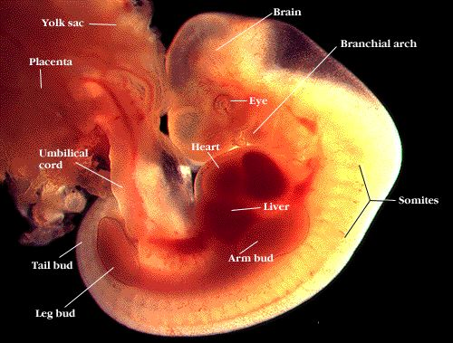
Parts of the Zygote

Slide 5
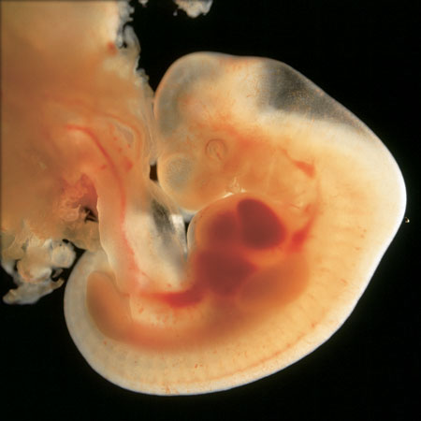
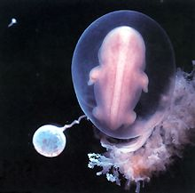
4 Weeks

Slide 6
The Embryo—Month 2
At 5 weeks the embryo is ¼ inch long
All major organ systems develop
The placenta and Umbilical Cord develop
  Placenta- The tissue that connects the sac around the unborn baby to the mother’s uterus
  Umbilical Cord- Tube that connects the baby to the placenta
    Brings the baby nourishment and oxygen from the mother’s blood
    Takes away waster products
Amniotic Fluid surrounds the baby
Face, and limbs take shape

Slide 7
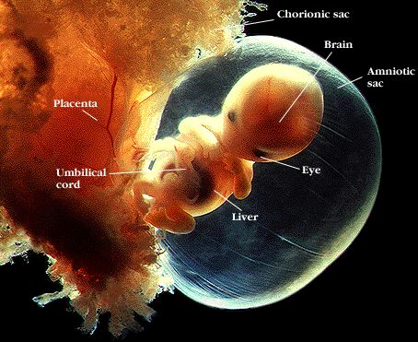
Two Months

Slide 8
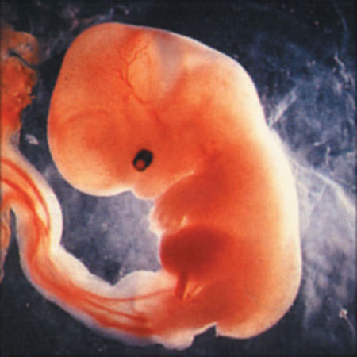
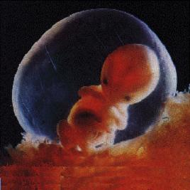
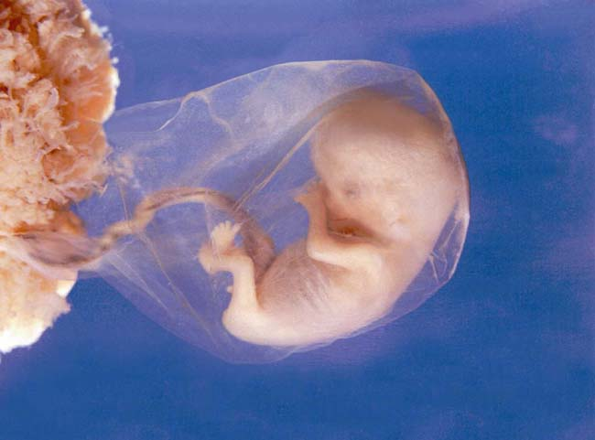
6 Weeks
7 Weeks
8 Weeks

Slide 9
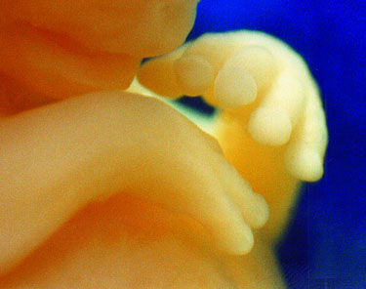
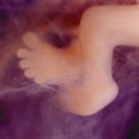
7 weeks
8 weeks

Slide 10
The Fetus—Month 3
The fetus is about 1 inch long
Nostrils, mouth, lips, teeth buds, and eyelids form
Fingers and toes are almost complete
Eyelids are fused shut
Arms, legs, fingers, and toes have developed
All internal organs are present—but aren’t ready to function
The genital organs can be recognized as male or female

Slide 11
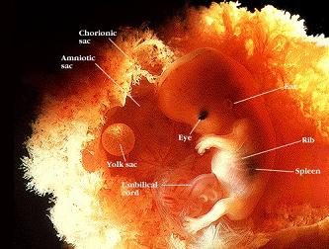
3 Months

Slide 12
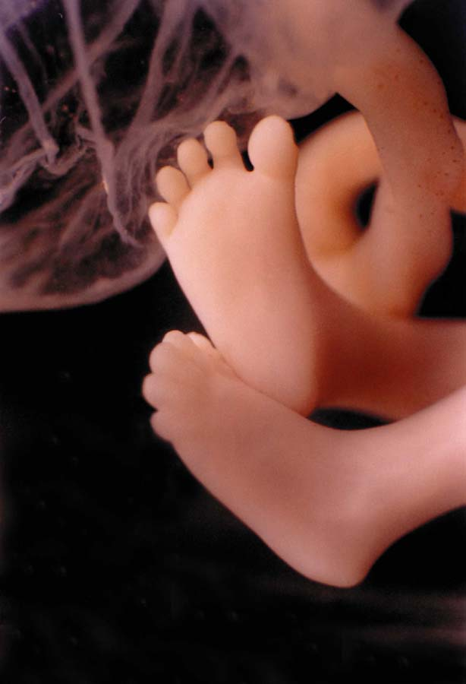
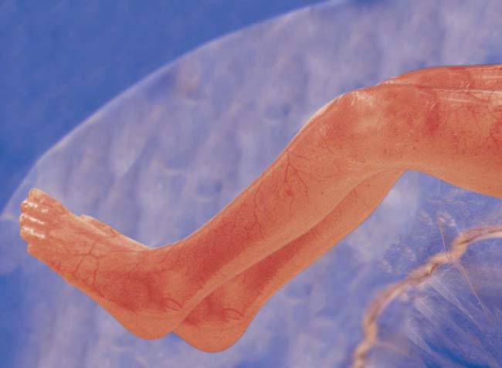
12 Weeks
11 Weeks

Slide 13
The Fetus—Month 4
Fetus is 3 inches long and weights 140 grams.
The baby is covered with a layer of thick, downy hair called lanugo.
Heartbeat can be heard clearly.
This may be when you feel your baby's first kick.
The baby can suck thumb, swallow and hiccup.

Slide 14
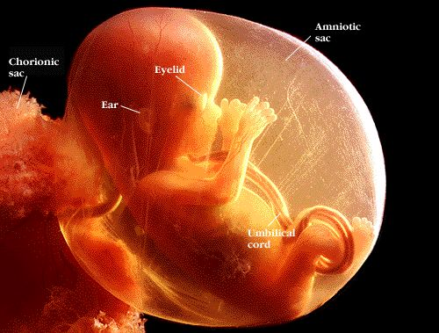
4 months

Slide 15
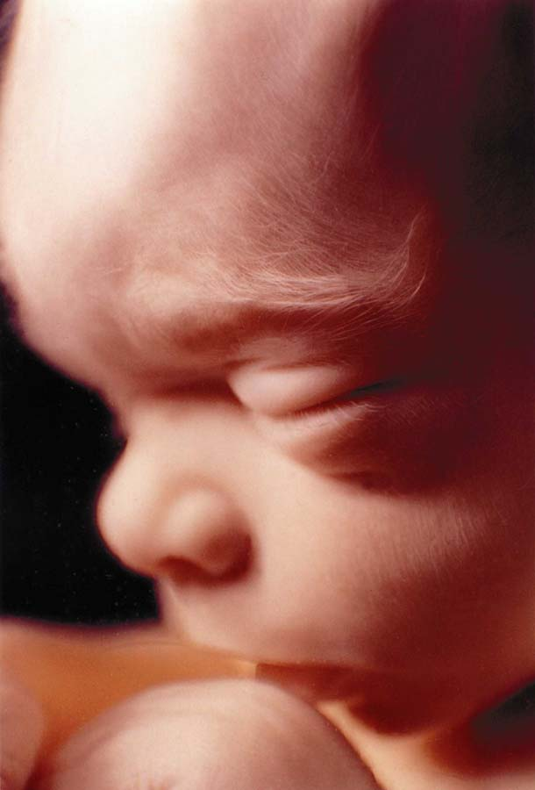
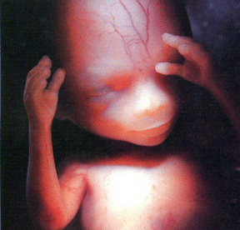
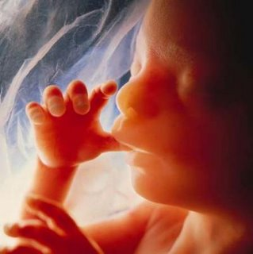
15 Weeks
18 Weeks
16 Weeks

Slide 16
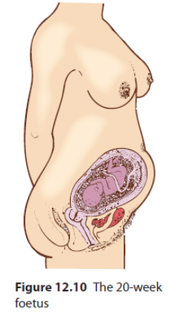
The Fetus—Month 5
The Fetus is about 6 inches long and weighs 160 grams.
A protective coating called vernix begins to form on baby's skin.
Hair eyelashes and eyebrows appear
Organs keep maturing
Fetus is very active
The eyes can open and blink

Slide 17
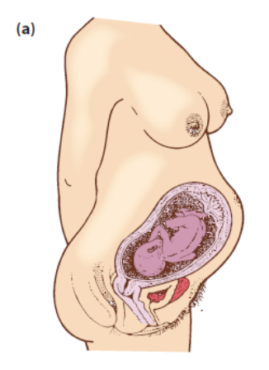
The Fetus—Month 6
The fetus is 8-10 inches long.
Your baby's lungs are filled with amniotic fluid, and has started breathing motions.
If you talk or sing, he can hear you.
Fat is starting to deposit under the skin

Slide 18
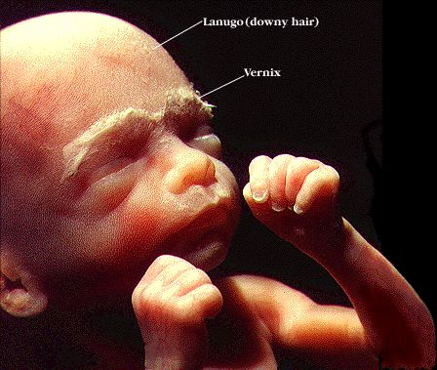
6 Months

Slide 19
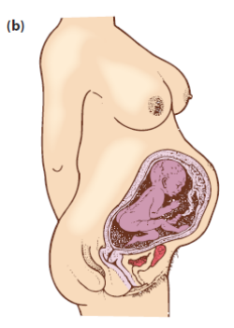
The Fetus—Month 7
Fetus is 10-12 inches long and weighs just under a kilogram
Fetus is active and then rests.
The baby now uses the four senses of vision, hearing, taste and touch

Slide 20
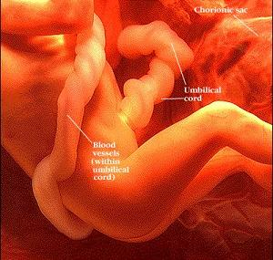
Seven Months

Slide 21
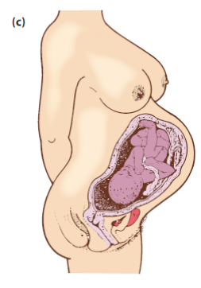
The Fetus—Month 8
The fetus is 14-16 inches long and weighs 1.4 kg
Layers of fat are piling on.
Fetus has probably turned head-down in preparation for birth.
Fetus may react to noises with a jerking action

Slide 22
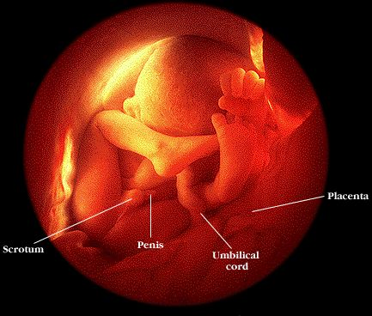
Eight Month

Slide 23
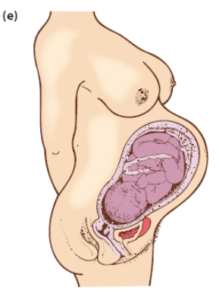
The Fetus—Month 9
Fetus is about 17-18 inches long and weighs 2.3 kg
Skin is smooth because of the fat
Baby’s movement slows down due to lack of room
“Lightening” occurs when the baby drops in the pelvis
Disease fighting antibodies are taken from the mother’s blood

Slide 24
Premature babies
Babies born before the 35th week of the pregnancy are termed premature
Babies can survive if born as early as the 23rd week. These babies typically weigh between 600-1000g and have a 50% chance of surviving
The organ systems of prem babies are still not fully developed, which can result in breathing problems and neurological damage

Slide 25
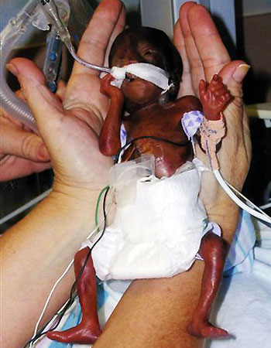
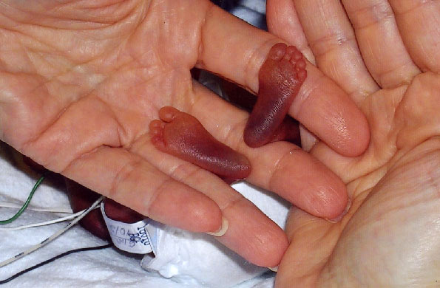
Smallest baby in the world born
At just 22 weeks
Her little feet
She was 283 GRAMS! when born and 9.5 inches. That's just longer than the length of your hand. She weighed less than a can of soda!

Slide 26
